Slide 1
AYAN DEEP HAZRA NLP GROUP 04/13/2021

Slide 2
Summary of Work
Date | Hours Worked | Description
04/13/2021 | 2 | Looked through the original parser
04/11/2021 | 4 | Tried to make changes to the Parser files and build one

Slide 3
Summary
Added a BulkModulus object in the model.py file.
Tried to build parser.

Slide 4
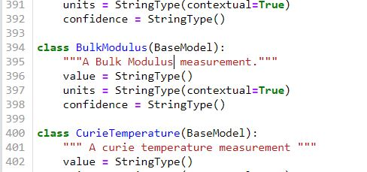
Results
Added BulkModulus to model.py
Was not able to solve some compilation errors.

Slide 5
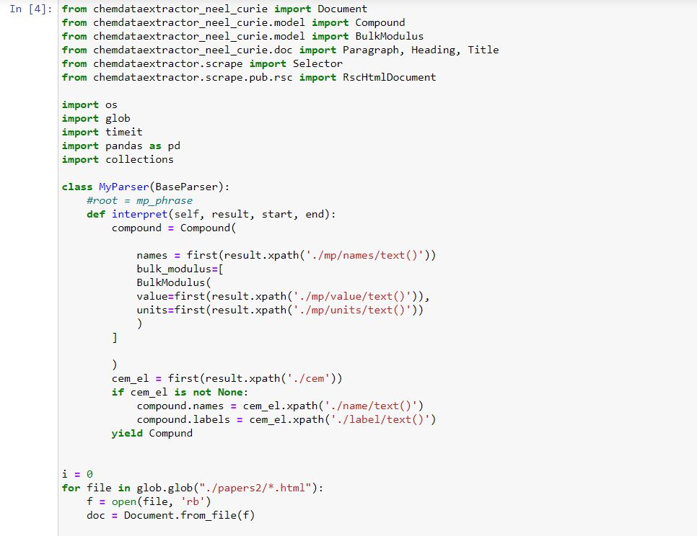

Slide 6
Next Steps
Need to understand how Base Parser works.
Have to use BaseParser to finish the parser.
XML parsing only
Use Document(Paragraph(text=”vvvsvfsvsfv”))
But instead of text make it XML

